Slide 1

User-Centered Design Principles
Creating Intuitive and Accessible Digital Experiences

Slide 2
What is User-Centered Design?
Focuses on the user's needs, goals, and behavior
Why It Matters
Benefits
Better usability, accessibility, and satisfaction
More engaged users, stronger brand loyalty, increased product success

Slide 3
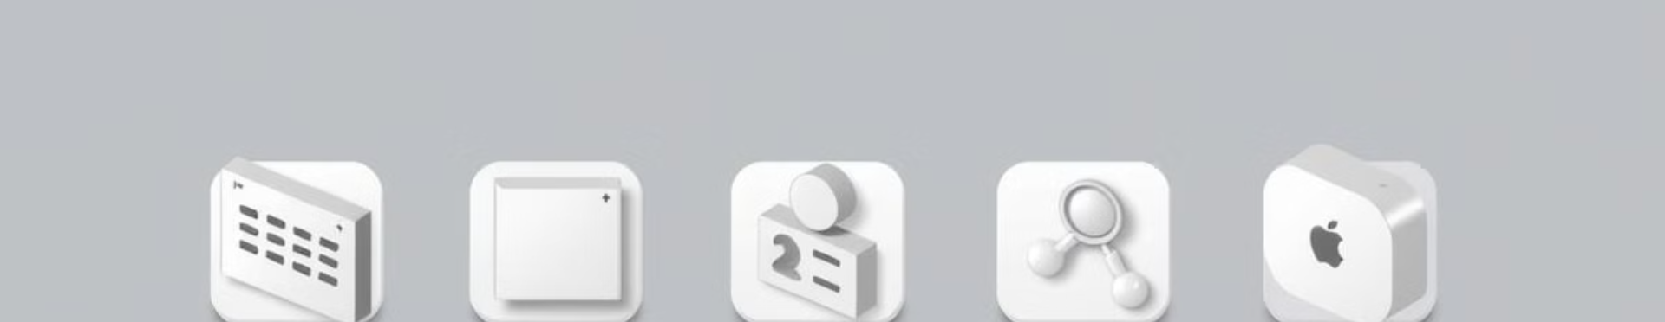





Key Principles of UI/UX
User Research
Consistency
Feedback & Iteration
Accessibility
Surveys, interviews, testing
Uniform layouts, typography, interactions
Improve based on user feedback
Design for all users

Slide 4
Standards for Accessibility & Usability
Accessibility
Usability
WCAG principles: Perceivable, Operable, Understandable, Robust (POUR)
Learnability, Efficiency, Memorability, Error Prevention, Satisfaction

Slide 5
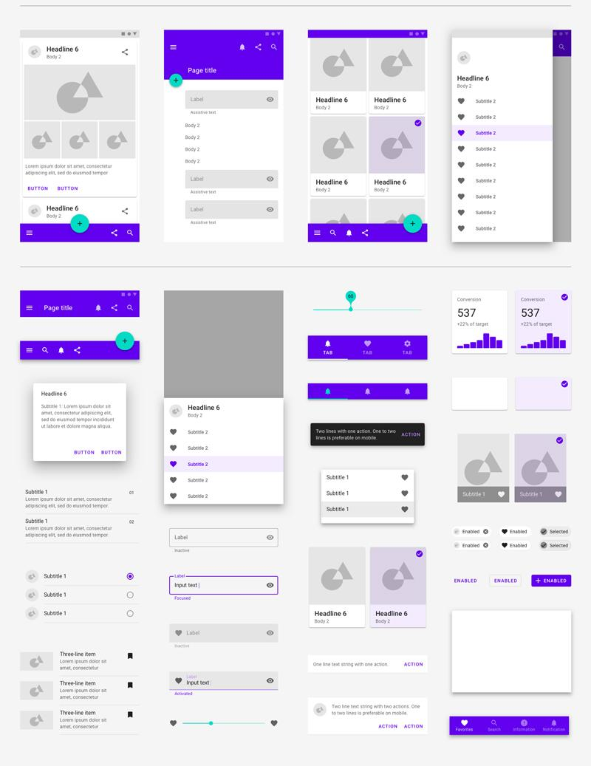
Material Design: A Google Approach
Real-world Inspired
Grid-based Layouts
Shadows, motion, depth
Consistent structure
Bold Typography
Clear and impactful

Slide 6



Human Interface Guidelines (HIG) - Apple
1
Clarity
2
Deference
3
Depth
Focuses on intuitive navigation and seamless user experiences

Slide 7
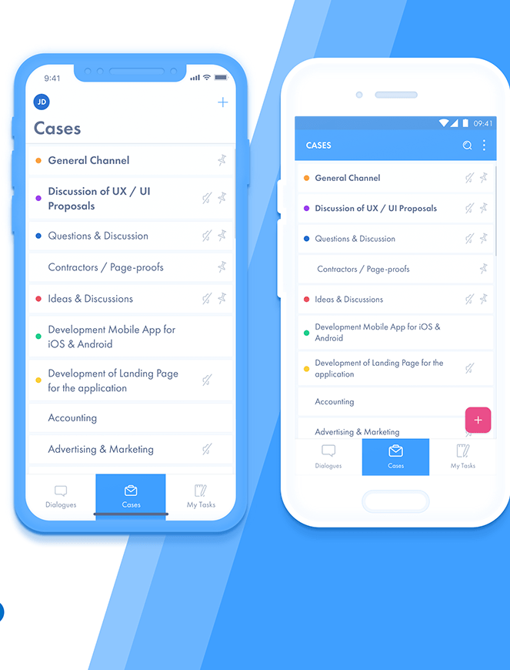
Feature | Material Design (Google) | Human Interface Guidelines (HIG) (Apple)
Philosophy | Inspired by real-world materials (paper & ink) with depth, shadows, and bold colors. | Focuses on clarity, deference, and depth with a flat yet layered design.
Platform Focus | Android, Web, and other Google products. | iOS, macOS, watchOS, and tvOS.
Visual Style | Uses cards, bold colors, shadows, and motion for hierarchy and interactivity. | Minimalistic, uses translucency, blurs, and subtle depth effects.
Navigation | Bottom navigation bar, drawer menus, FABs (Floating Action Buttons). | Tab bars, sidebars, and gesture-based navigation.
Typography | Uses Roboto and Noto fonts. | Uses San Francisco (SF) font.
Buttons | Emphasizes floating action buttons (FAB) and touch ripples. | Prefers simple buttons with clear labels and subtle animations.
Gestures | Supports swipe gestures but relies more on buttons for interactions. | Heavy use of gestures (swipes, pinches, force touch).
Customization | Flexible theming with Material You for personalized UI. | Standardized look with limited theming options.
Material Design vs. HIG

Slide 8
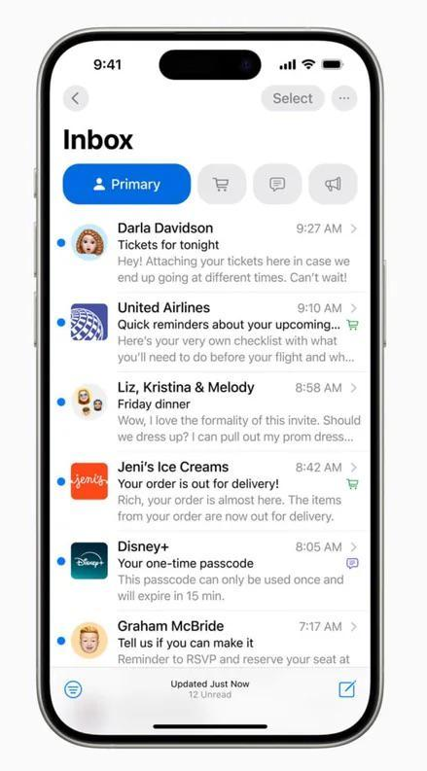
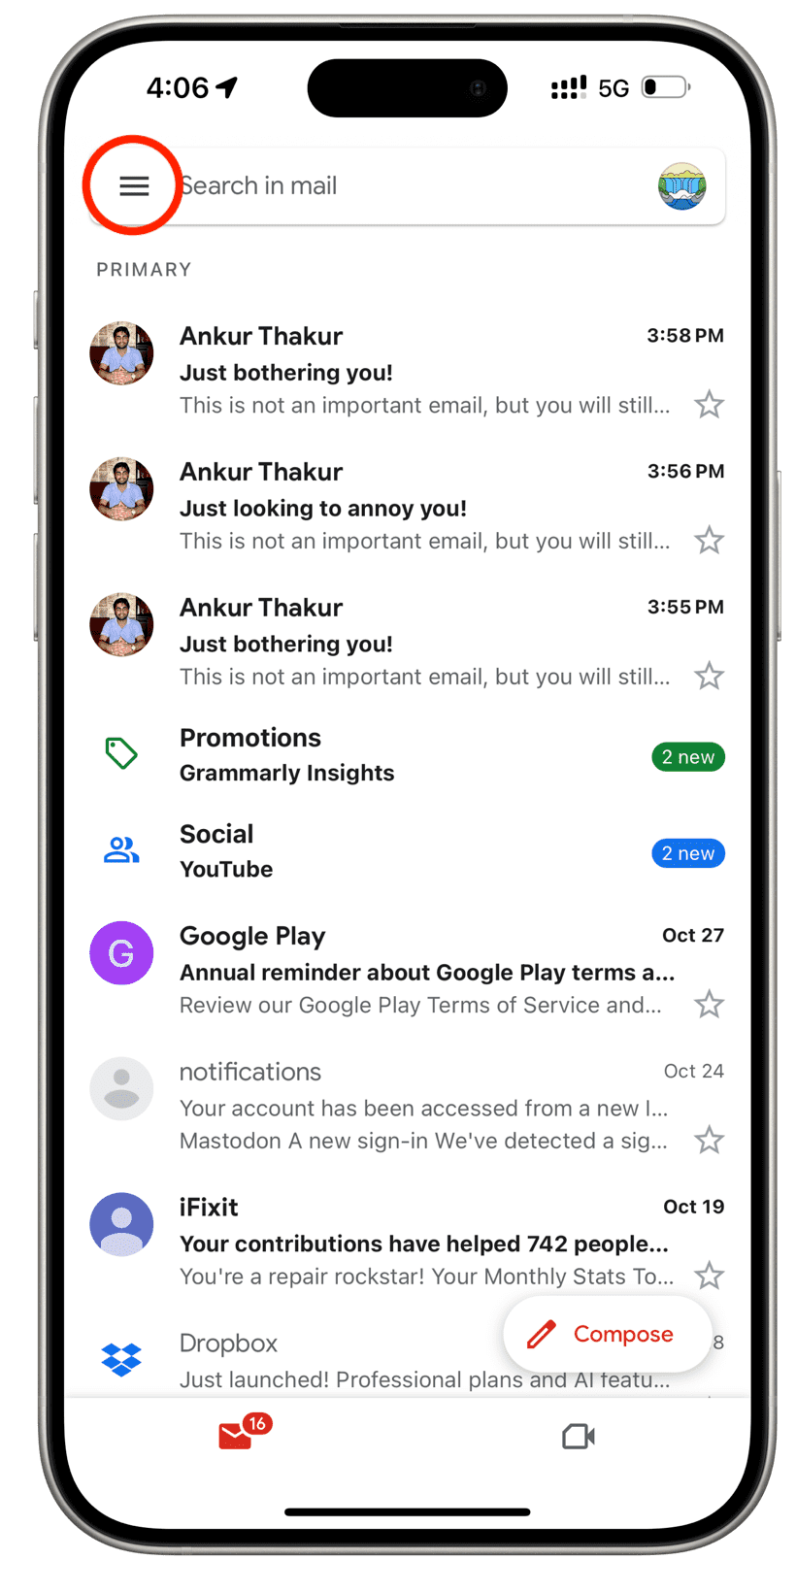
Examples
Google Apps (Material Design): Gmail
Apple Apps (HIG): iOS Mail

Slide 9
Thank you

